Slide 1
Lawrence Sperry
The BEST

Slide 2
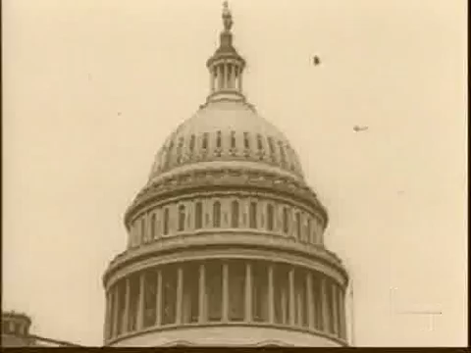
I departed to Moscow

Slide 3
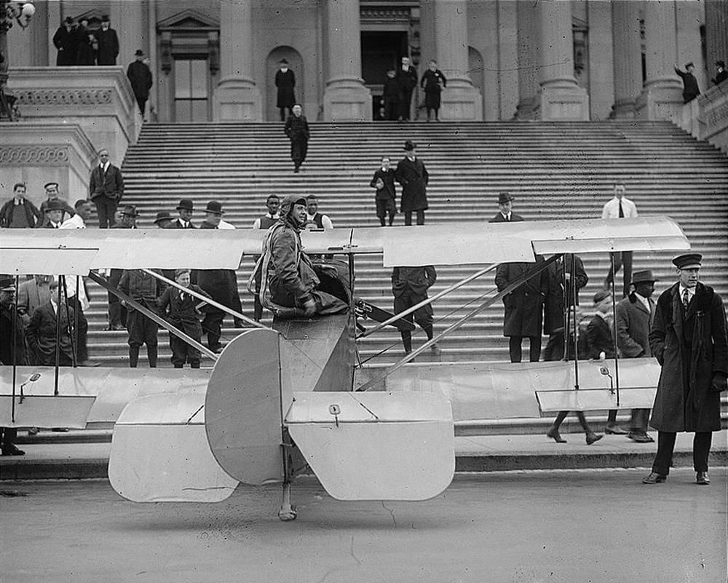
W h e r e I?

Slide 4
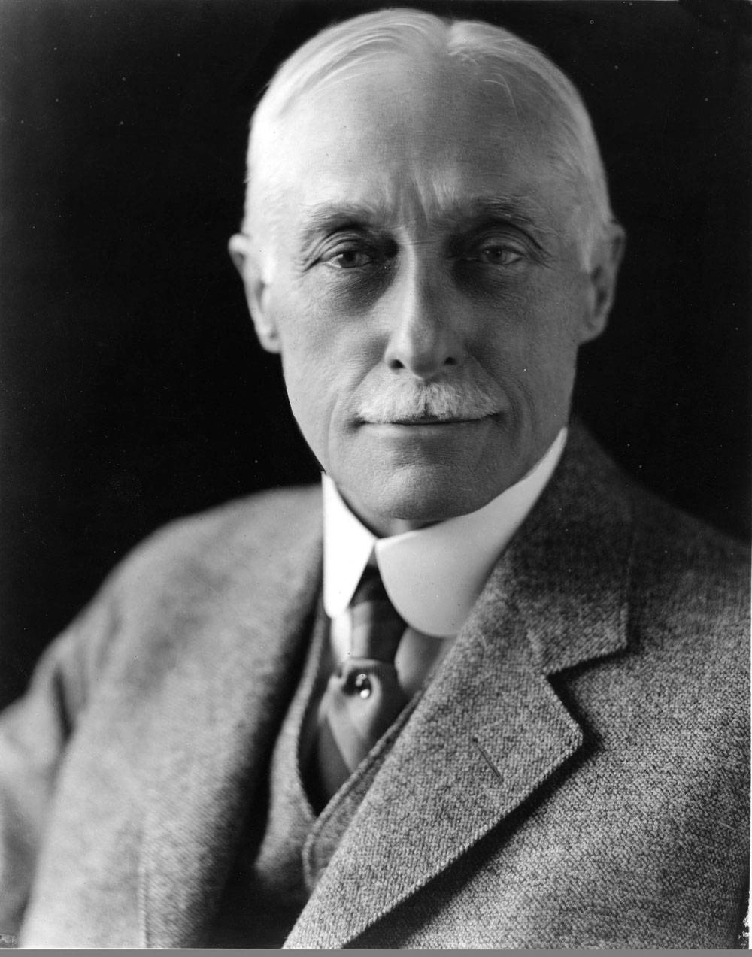
My father of the most honest rules?!

Slide 5
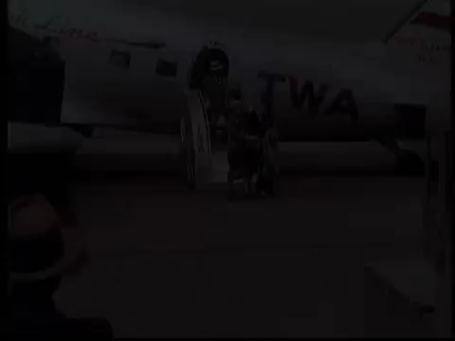
It about me, LOL

Slide 6
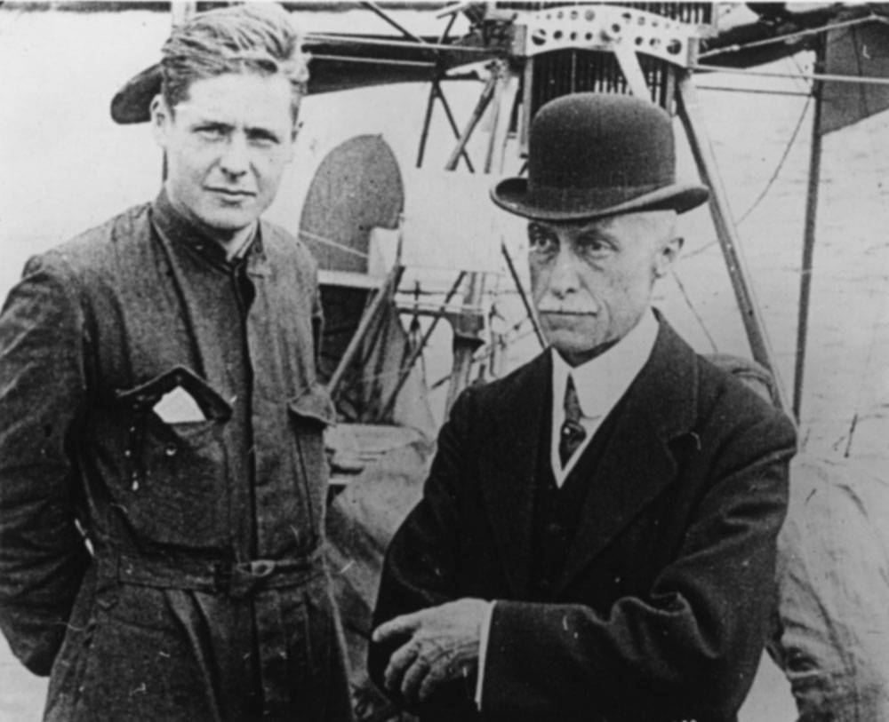
It is my BRO!

Slide 7
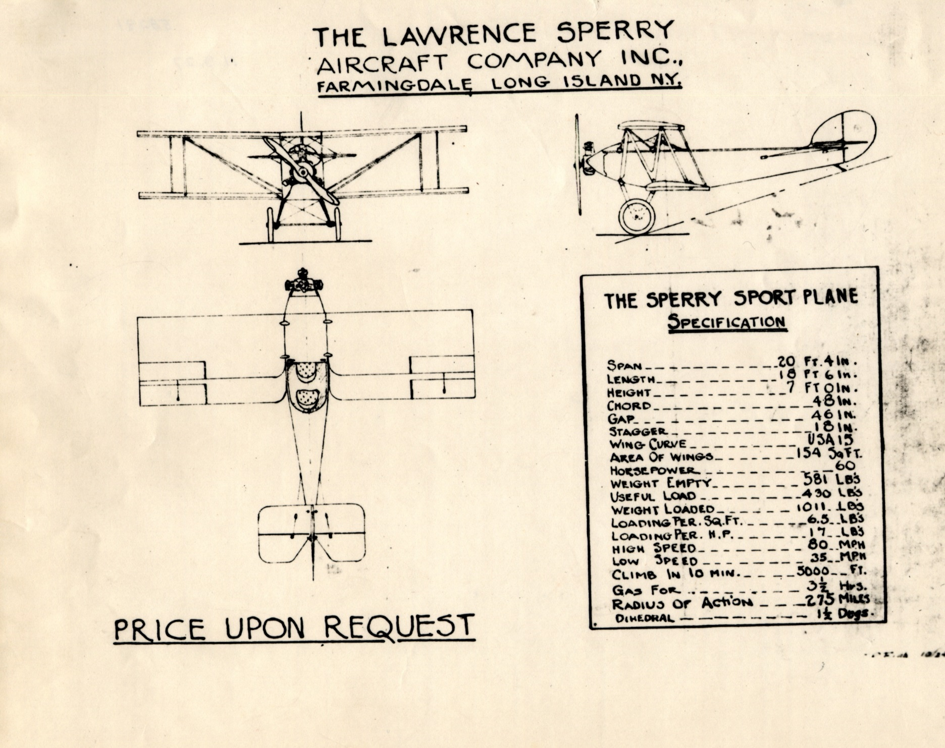
Beautifully, beautifully

Slide 8
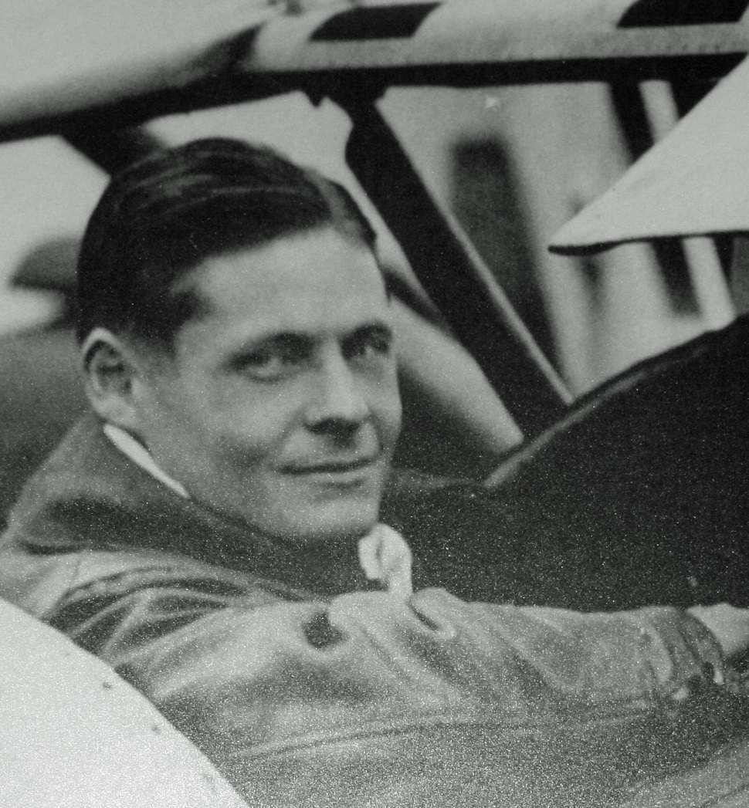

Don't despair, at you too all it to turn out.

Slide 9
The end

